Slide 1


Sale of Goods Act, 1893
Proton Energy v Orlen Lietuva
Description or Quality?
[2013] EWHC 2872 (Comm), QBD

Slide 2

One Question, $1.36 Million
Is the specification part of the description, or only quality?
Description: Orlen may reject the cargo
Quality: the contract lives, the remedy is damages

Slide 3
The Deal
01
02
03
14 Jun: firm offer, 25,000 MT, spec attached
14 Jun: Orlen confirms; Proton buys from Trafigura
29 Jun: Orlen withdraws; cargo refused; $1.36m claimed

Slide 4

Orlen’s entire reply, 14 June 2012
"Confirmed."
Proton bought the cargo from Trafigura the same day
Held: a binding contract was concluded that day

Slide 5
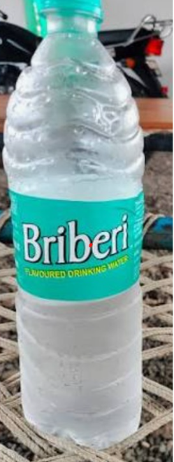


Slide 6



Slide 7


s.11: a condition gives a right to reject, a warranty only damages
Three Sections
s.13: in a sale by description, the goods must match the description
s.14(4): parties may make a quality term an express condition

Slide 8

The Two Cases
ORLEN: only the spec identifies this cargo
ORLEN: slight discrepancy, right to reject
PROTON: specs move on a voyage, rejection is uncommercial
PROTON: the spec sits in the Quality clause

Slide 9


Where the Spec Sat
Clause 3 "Product": Oil Blend, CN 2710, the description
Clause 4 "Quality": the SGS loadport analysis, and the spec
Tradax and R G Grain: a limit under a quality heading is quality

Slide 10

Before the ruling
Hands up, and commit
Could Orlen Reject?
Yes: the specification is description
No: it is only a matter of quality

Slide 11

Not a sale by description:
Worse is not Different
the contract itself separates Product from Quality
Termination unjustified:
Proton recovers damages, less Orlen’s quality losses
s.13 protects against different, not against worse

Slide 12

What to Take Away
Condition or warranty decides the remedy, not the severity of the breach.
Description is identity; quality is how good it is. Headings are not decoration: make a deal-critical number an express condition.
SOGA 1930
ss. 15 & 16
Same rule in India

